Slide 1
Qualitative Surveys
Dirk Riehle, Univ. Erlangen
NYT D03
Licensed under CC BY 4.0 International

Slide 2
Agenda
Qualitative surveys
Qualitative vs. quantitative surveys
Purposive sampling
Data collection
Data analysis
Quality assurance

Slide 3
1. Qualitative Surveys

Slide 4
Qualitative Surveys
A survey is
The study of a population through observation of its members
A qualitative survey is a survey studying
Diversity (not distribution) in a population for theory building purposes
Qualitative surveys may be the simplest possible theory building methodology
The most common variant is the interview study

Slide 5
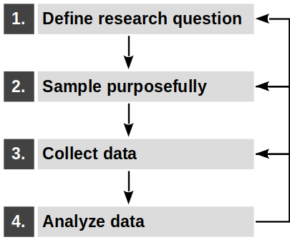
Qualitative Survey Process
Qualitative surveys use defined research methods to
Define research question
Create sampling model and sample
Perform data collection
Analyze data
A qualitative survey should follow a defined methodology, for example,
Jansen (2010)

Slide 6
Open vs. Pre-structured Qualitative Surveys
Jansen (2010) distinguishes between
Open (inductive) qualitative surveys (for theory building)
Pre-structured (deductive) qualitative surveys for measuring diversity

Slide 7
Pre-Structured (Deductive) Qualitative Surveys
A pre-structured qualitative survey, according to Jansen (2010)
Quantitatively assesses diversity in a population using established categories
As such, this type of survey is descriptive and findings have to fit the mold
Which of a set of predefined characteristics exist in a given population?
We do not consider this type of survey further (not theory building)

Slide 8
Example QS Episodic Volunteer Retention (EVR) RQ [1]
How do open source projects retain episodic volunteers?
How do these practices relate to traditional retention practices?
Open source projects rely on free “volunteer” contributions
Some of these volunteers are habitual, some are episodic
[1] Barcomb, A., Kaufmann, A., Riehle, D., Stol KJ, & Fitzgerald, B. (2020). Uncovering the Periphery: A Qualitative Survey of Episodic Volunteering in Free/Libre and Open Source Software Communities. IEEE Transactions on Software Engineering, vol. 46, no. 9 (September 2020), pp. 962-980.

Slide 9
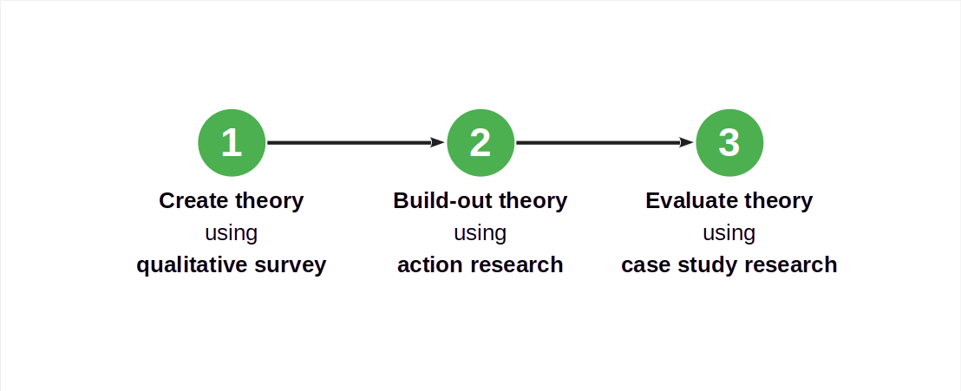
Qualitative Surveys in a Larger Research Design

Slide 10
2. Qualitative vs. Quantitative Surveys

Slide 11
Qualitative vs. Statistical (Quantitative) Surveys 1 / 2
A qualitative survey studies
Diversity (of variables) in a population where
A statistical (quantitative) survey studies
Distribution (of variables) in a population where

Slide 12
Example of a Statistical Survey [1]
To what extent are the following six proposed theoretical constructs indicative of an episodic volunteers intention to remain a volunteer to a project?
Volunteering experience
Contributor benefit motivations
Psychological sense of community
Community commitment
Social norms
Satisfaction
These constructs were an outcome of the example qualitative survey research
[1] Barcomb, A., Stol KJ, Riehle, D. & Fitzgerald, B. (2019). Why Do Episodic Volunteers Stay in FLOSS Communities? In Proceedings of the 41st International Conference on Software Engineering (ICSE 2019), pp. 948-959.

Slide 13
Qualitative vs. Quantitative Surveys 2 / 2
Steps | Qualitative Survey | Statistical Survey
Study purpose | Diversity / insight | Distribution / hypothesis testing
Population sampling | Theoretical / purposive | (Stratified) Random
Variable scales | Nominal or ordinal | Interval or ratio
Stopping criterion | Theoretical saturation | Statistical significance
Results | Theoretical / causal insights | Correlations

Slide 14
Example Qualitative vs. Statistical Survey Comparison
Steps | A qualitative survey of episodic volunteering | A hypothesis-testing survey of episodic volunteering practices
Study purpose | Understand retention practices for episodic volunteers | Testing relevance of constructs for intention to remain
Population sampling | Project leaders from diverse set of projects | Open questionnaire advertised (“convenience sampling”)
Variable scales | Categorical | Interval / distribution
Stopping criterion | Saturation of learning about new practices | Time and effort
Results | A set of retention practices | A (in)validation of practices

Slide 15
3. Purposive Sampling

Slide 16
Purposive Sampling
Sampling is
The selection of members (the sample) of a population for investigation
Purposive sampling is sampling in which the selection
Is purposeful for theory building
Theoretical sampling is a variant of purposive sampling
Used in grounded theory research

Slide 17
Sampling Model and Population
A sampling model
Is a model of the population designed to sample from
Focuses on the properties of relevance to the research question
The population is
The set of elements characterized by the sampling model

Slide 18
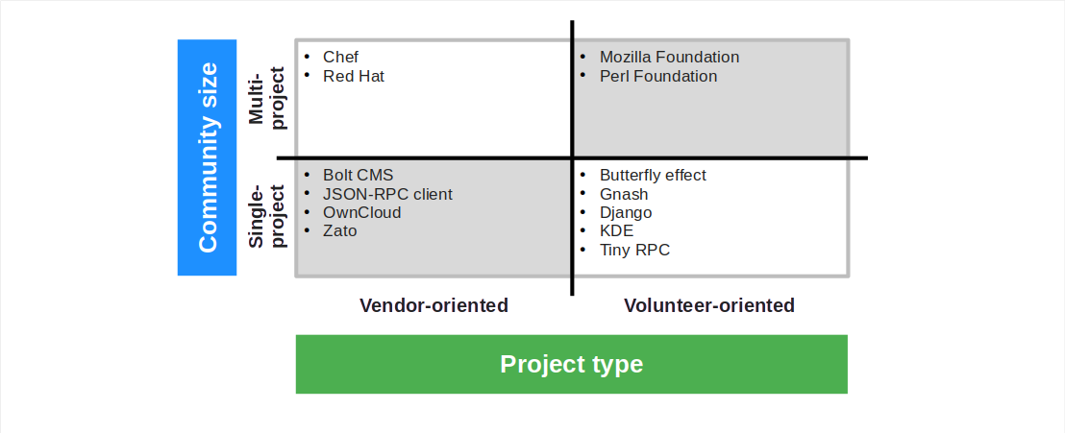
Example QS EVR Sampling Model with Sample

Slide 19
How to Build a Sampling Model?
The sampling model already incorporates assumptions (biases) about the domain
It should be derived from prior work, for example, a systematic literature review
In situations of high uncertainty, start with a small model and revise over time

Slide 20
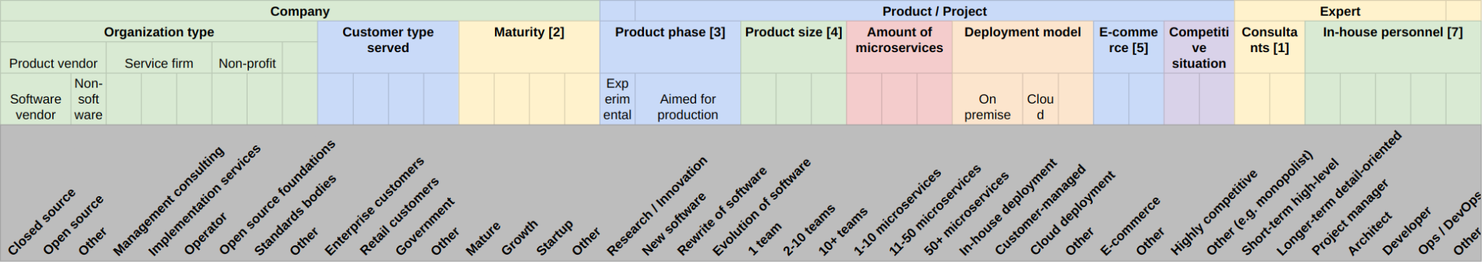
Example Microservice Integration Sampling Model
Interview study of domain experts on best practices of microservice integration
Population were experts of microservice architectures
Diversity sought out was captured by model

Slide 21
Purposive Sampling Strategies
Purposive sampling strategies
Typical case sampling
Chooses a common representative case
Critical case sampling
Chooses outlier cases for theoretical insight
Polar sampling
Chooses sets of elements based on opposing attributes

Slide 22
Sample Sizes
The initial sample should broadly cover the existing diversity
Grow sample (add more elements) as you work towards saturation
Heuristics for initial sample sizes
Recommendations by other experts in the domain
Recommendations from qualitative methodologist
Prior knowledge about reaching saturation
Notes:
Marshall, B., Cardon, P., Poddar, A., & Fontenot, R. (2013). Does sample size matter in qualitative research?: A review of qualitative interviews in IS research. Journal of computer information systems, 54(1), 11-22.
Onwuegbuzie, A. J., & Leech, N. L. “A call for qualitative power analyses,” Quality & Quantity, (41), 2007, 105-121.

Slide 23
Recommendations for Sample Sizes
Some recommendations by qualitative methodologists for
Grounded theory research
Creswell (2007): At least 20 to 30 interviewees
Denzin and Lincoln (2005): About 30 to 50 interviews
Morse (2000): About 20 to 30 interviewees.
Case study research
Creswell (2007): Max. 4 or 5 cases and 3 to 5 interviewees per case
Notes:
Marshall, B., Cardon, P., Poddar, A., & Fontenot, R. (2013). Does sample size matter in qualitative research?: A review of qualitative interviews in IS research. Journal of computer information systems, 54(1), 11-22.
Creswell, J. W. Qualitative inquiry & research design: Choosing among five approaches (2nd ed.). Sage, Thousand Oaks, CA, 2007.
Denzin, N. K., & Lincoln Y. S. “The discipline and practice of qualitative research,” In N. K. Denzin & Y. S. Lincoln (Eds.), The Sage Handbook of Qualitative Research (3rd ed.), Sage, Thousand Oaks, CA, 2005, 1-32.
Morse, J. M. “Determining sample size,” Qualitative Health Research, (10:1), 2000, 3-5.
Yin, R. Case Study Research: Design and Methods (4th ed.). Sage, Thousand Oaks, CA, 2009.

Slide 24
4. Data Collection

Slide 25
Qualitative Surveys as Interview Studies
Types of interviews
Unstructured
Semi-structured
(Fully) structured
Types of interviewees
Individual person
Groups of people
Notes:
References:
Fontana, A., & Frey, J. H. (2000). The interview: From structured questions to negotiated text. Handbook of qualitative research, 2(6), 645-672.
DiCicco‐Bloom, B., & Crabtree, B. F. (2006). The qualitative research interview. Medical education, 40(4), 314-321.

Slide 26
Unstructured Interviews
Unstructured interviews
Have open-ended questions, are “in-depth interviews”
Allow order of questions, emphasis, and depth to vary by interview
Are managed and adapted in the situation by the interviewer
Do not impose any prior categorization on collected data
Notes:
References:
Fontana, A., & Frey, J. H. (2000). The interview: From structured questions to negotiated text. Handbook of qualitative research, 2(6), 645-672.
DiCicco‐Bloom, B., & Crabtree, B. F. (2006). The qualitative research interview. Medical education, 40(4), 314-321.
Bryman, A. (2016). Social research methods. Oxford university press.

Slide 27
Structured Interviews
Fully structured interviews
Have a predetermined question set, with little room for variation
Have a predetermined order and no variation between interviewees
Contain closed questions (fixed set of answer choices)
Are created from an existing coding scheme for the responses
Aim to categorize behavior within pre-established categories
Structured interviews are not used in theory building
They are effectively a statistical survey
Notes:
References:
Fontana, A., & Frey, J. H. (2000). The interview: From structured questions to negotiated text. Handbook of qualitative research, 2(6), 645-672.
DiCicco‐Bloom, B., & Crabtree, B. F. (2006). The qualitative research interview. Medical education, 40(4), 314-321.
Bryman, A. (2016). Social research methods. Oxford university press.

Slide 28
Semi-Structured Interviews
Semi-structured interviews are
Interviews with both a structured and unstructured part
Theory building (unstructured part) tends to dominate
Structured part to add some statistical data to better understand the population
Notes:
References:
Fontana, A., & Frey, J. H. (2000). The interview: From structured questions to negotiated text. Handbook of qualitative research, 2(6), 645-672.
DiCicco‐Bloom, B., & Crabtree, B. F. (2006). The qualitative research interview. Medical education, 40(4), 314-321.
Jansen, H. (2010). The logic of qualitative survey research and its position in the field of social research methods. In Forum Qualitative Sozialforschung/Forum: Qualitative Social Research (Vol. 11, No. 2).

Slide 29
Why an Interview Study?
“Industry [1] is where the research data is.” [DR]
[1] Or just “practice”

Slide 30
Interview Study Process (for Theory Building)
For each selected interviewee
Prepare protocol
Setup protocol, prepare questions
Updated questions if needed
Perform interview
Interview current interviewee
Capture and transcribe interview
Analyze results
Perform qualitative data analysis
Check saturation, iterate if necessary

Slide 31
1. Prepare Protocol
Prepare protocol
Document all relevant meta-data, for example, interviewee name, etc.
Outline (if doing it for the first time) or amend process
Prepare questions
What and how to ask based on research question
Structure questions into categories, have order
Usually start with some demographics
Go from the general to the specific
Have a closing, follow-up, thank you
Notes:
Roberts, R. E. (2020). Qualitative Interview Questions: Guidance for Novice Researchers. Qualitative Report, 25(9).

Slide 32
2. Perform Interview 1 / 3
Follow your interview guide (questions)
Introductory comments
Clarify purpose of interview
Ask for permission to record interview
Explain purpose of recording
Allow for off the record remarks
Inquire about use of quotes
Interview conversation
Record the spoken word (audio)
Take notes on non-verbal information
Prefer open-ended questions

Slide 33
Example QS EVR Interview Protocol [1]
Guide for community managers
Introduction
Establish subject’s authority
Understand what the interview subject means by volunteering
What types of episodic volunteering are present
What does episodic volunteering look like
How are episodic volunteers managed
Which activities are best suited to episodic volunteers
Which activities are not suited to episodic volunteers
Conclusion
Guide for episodic volunteers
Introduction
Episodic volunteering pattern in a community
Motives and Intentions
What initially inspired you to volunteer
Do you intend to continue to volunteer
How do you make that decision
Experiences
Practices
Volunteering identity/behavior
Conclusion
Do you have additional insights
[1] See https://ieeexplore.ieee.org/ielx7/32/4359463/8477174/appendix-uncovering-periphery.pdf

Slide 34
2. Perform Interview 2 / 2
Follow interview guide (questions) but do not be afraid to
Reorder questions
Rephrase, reiterate questions
Go off course if answers warrant it!
Be open-minded, avoid leading questions, etc.
Let the interviewee talk but pull them back to the topic if they digress

Slide 35
2. Perform Interview 3 / 3
After the interview
Transcribe the audio recording; your options
Manually convert audio to text
Use an auto-transcription tool
Outsource to transcription service
Check the transcript manually
Correct the sentences if necessary
Delete off-the-record parts
Send the transcription to the interviewee to get confirmation

Slide 36
Other Data Sources / Primary Materials
Existing documents / documentation
Workshop notes / transcripts
Participant observation
Outside observations
…

Slide 37
5. Data Analysis

Slide 38
Interview Study Process (Continued)
For each selected interviewee
Prepare protocol
Setup protocol, prepare questions
Updated questions if needed
Perform interview
Interview current interviewee
Capture and transcribe interview
Analyze results
Perform qualitative data analysis
Check saturation, iterate if necessary

Slide 39
Three Levels of Diversity Analysis
There are three levels (types) of analysis according to Jansen (201)
Unidimensional description (of collected data)
Data → Object, Object → Dimensions, Dimensions → Categories
Multidimensional description
Concept-oriented and case-oriented description
Explanation
Qualitative data analysis
Notes:
Jansen, H. (2010). The logic of qualitative survey research and its position in the field of social research methods. In Forum Qualitative Sozialforschung/Forum: Qualitative Social Research (Vol. 11, No. 2).

Slide 40
Coding Paradigm Comparison
Grounded theory (Corbin & Strauss, 2008) | Thematic analysis (Braun & Clarke, 2012) | The qualitative survey (Jansen, 2010)
Open coding | Initial coding and collation | –
Axial coding | Searching for themes | Upward coding Downward coding
Selective coding | Reviewing themes | –

Slide 41
Until Saturation is Reached
Until saturation criterion tied to analysis method is reached

Slide 42
Example QS EVR Saturation Criterion
After 14 interviews (out of 20 in total) all codes were set

Slide 43
6. Quality Assurance

Slide 44
Quality Assurance
Quality assurance is tied to the individual research methods
Systematic literature review → sampling model and sampling
Qualitative data analysis → data analysis

Slide 45
Examples QS EVR Quality Assurance
First iteration
Two coders, with the second coder recoding the first coder’s work
Second iteration
Same procedure, with the second coder being a distributed coding team
In each iteration, the codebook was discussed and revised

Slide 46
Summary
Qualitative surveys
Qualitative vs. quantitative surveys
Purposive sampling
Data collection
Data analysis
Quality assurance

Slide 47
Thank you! Any questions?
dirk.riehle@fau.de – https://oss.cs.fau.de
dirk@riehle.org – https://dirkriehle.com – @dirkriehle

Slide 48
Legal Notices
License
Licensed under the CC BY 4.0 International license
Copyright
© Copyright 2012-2023 Dirk Riehle, some rights reserved

